Slide 1

STATISTICAL LEARNING & ASSOCIATION RULES MINING
SETTING THE STAGE
“Data science does not replace statistical modeling and data analysis; it augments them.”
(P. Boily)
“Data is not information, information is not knowledge, knowledge is not understanding, understanding is not wisdom.”
(attributed to Cliff Stoll in Keeler's Nothing to Hide: Privacy in the 21st Century, 2006)
data-action-lab.com

Slide 2
What is Data Science? (REPRISE)
Data Science (DS) is the collection of processes by which we extract useful and actionable insights from data.
(paraphrased from T. Kwartler)
DS is the working intersection of statistics, engineering, computer science, domain expertise, and “hacking.” It involves two main thrusts: analytics (counting things) and inventing new techniques to draw insights from data.
(paraphrased from H. Mason)

Slide 3
Learning in General
Beyond “just taking a quick look,” humans learn through:
answering questions
testing hypotheses
creating concepts
making predictions
creating categories and classifying objects
grouping objects
The central Data Science/Machine Learning problem is:
can we design algorithms that can learn?

Slide 4
Types of Learning
Supervised Learning (learning with a teacher)
classification, regression, rankings, recommendations
uses labeled training data (student gives an answer to each test question based on what they learned from worked-out examples)
performance is evaluated using testing data (teacher provides the correct answers)
Unsupervised Learning (grouping similar exercises together as a study aid)
clustering, association rules discovery, link profiling, anomaly detection
uses unlabeled observations (teacher is not involved)
accuracy cannot be evaluated (students might not end up with the same groupings)

Slide 5
Types of Learning
Semi-Supervised Learning (teacher providing worked-out examples and a list of unsolved problems)
Reinforcement Learning (embarking on a Ph.D. with an advisor)
______________________________
In supervised learning, there’s a target against which to train the model. In unsuper-vised learning, we don’t know what the target is, or even if there is one.
The distinction is crucial. Make sure you understand it.

Slide 6
CASE STUDY: DANISH MEDICAL STUDY
[Jensen, A.B., et al. [2014], Temporal disease trajectories condensed from population-wide registry data covering 6.2 million patients, Nature Communications]
The Danish National Patient Registry contains 68 million health observations on 6.2 million patients over a 15 year time span (Jan ‘96 – Nov ‘10).
Objectives:
finding connections between different diagnoses
determining how a diagnosis at some point in time might allow for the prediction of another diagnosis at a later point in time

Slide 7
Methodology
Compute strength of correlation for pairs of diagnoses over a 5 year interval on a representative subset of the data
Test diagnoses pairs for directionality (one diagnosis repeatedly occurring before the other)
Determine reasonable diagnosis trajectories (thoroughfares) by combining smaller frequent trajectories with overlapping diagnoses
Validate the trajectories by comparison with non-Danish data
Cluster the thoroughfares to identify central medical conditions (key diagnoses) around which disease progression is organized

Slide 8
Results
Data was reduced to 1,171 thoroughfares on the course of
diabetes
chronic obstructive pulmonary disease (COPD)
cancer
arthritis
cardiovascular disease.
The data analysis showed, for example:
diagnoses of anemia followed later by the discovery of colon cancer
gout was identified as a step toward cardiovascular disease.
COPD is under-diagnosed and under-treated.

Slide 9
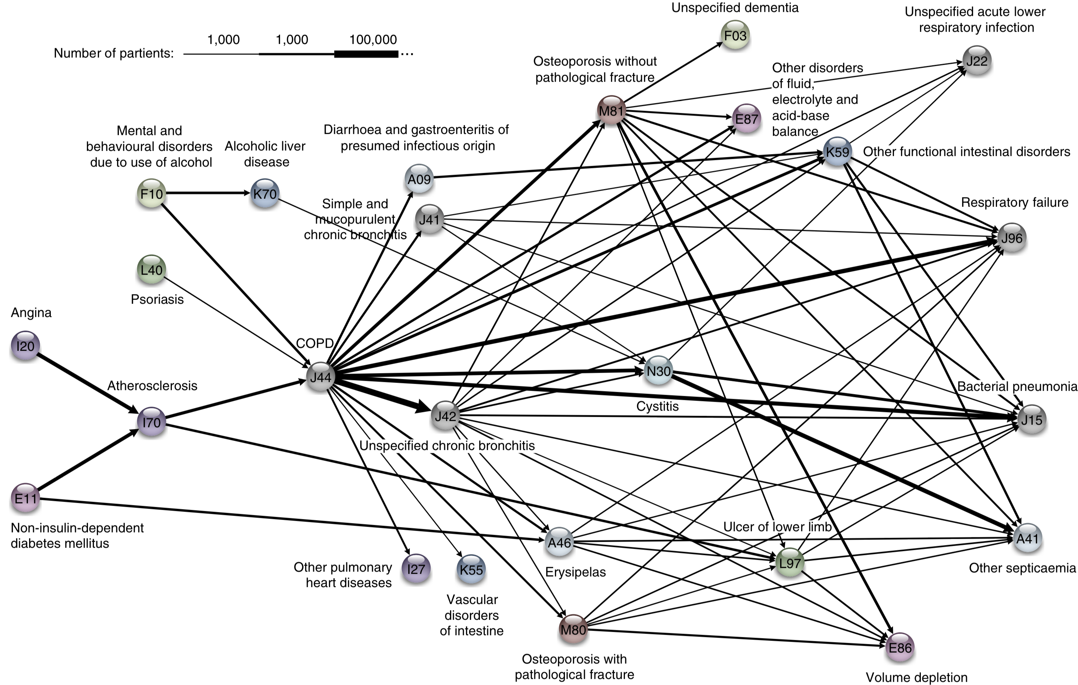

Slide 10
Association Rules Basics
Association Rule Discovery is a type of unsupervised learning that finds connections among attributes (and combinations of attributes).
Example: we might analyze a dataset on the physical activities and purchasing habits of North Americans and discover that
runners who are also triathletes (the premise) tend to drive Subarus, drink microbrews, and use smartphones (the conclusion), or
individuals who have purchased home gym equipment are unlikely to be using it 1 year later (to name some fictitious possibilities)

Slide 11
Original Application
Supermarkets record the contents of shopping carts at check-outs to determine items which are frequently purchased together.
Examples:
bread and milk are often purchased together, but that’s not so interesting given how often they are purchased individually
hot dogs and mustard are also often purchased as a pair, but more rarely purchased individually
A supermarket could then have a sale on hot dogs while raising the price on condiments.

Slide 12
Other Applications
Related Concepts
looking for pairs (triplets, etc) of words that represent a joint concept
{Ottawa, Senators}, {Michelle, Obama}, {veni, vidi, vici}, etc.
Plagiarism
looking for sentences that appear in various documents
looking for documents that share sentences
Biomarkers
diseases that are frequently associated with a set of biomarkers

Slide 13
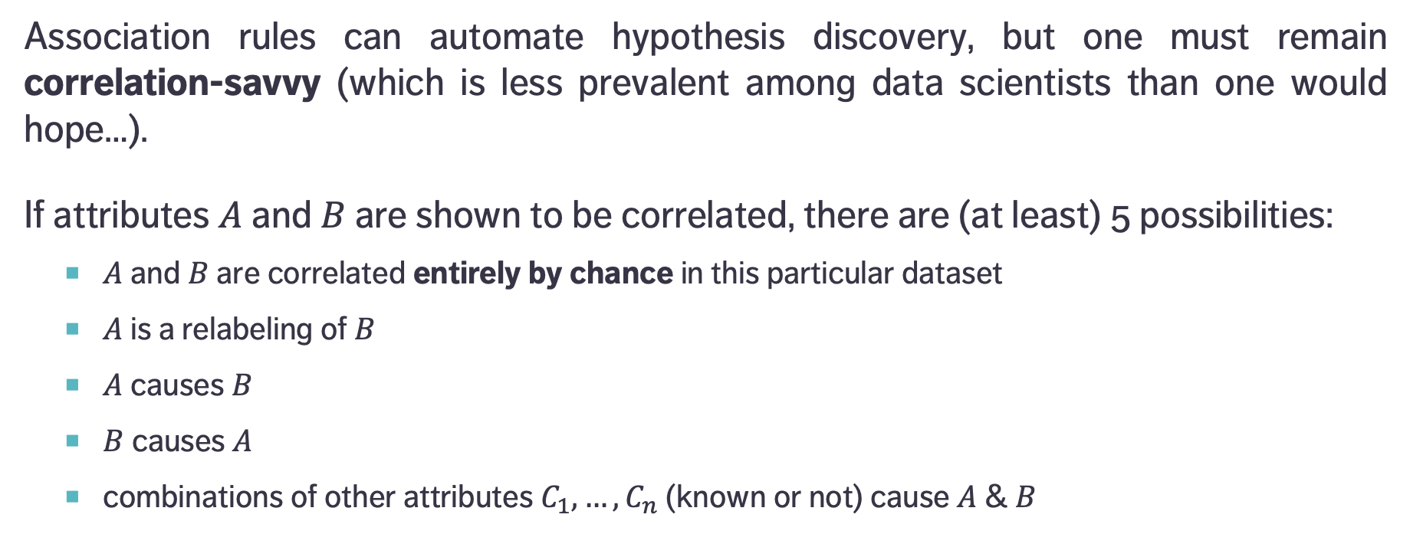
Causation and Correlation
Association rules can automate hypothesis discovery, but one must remain correlation-savvy (which is less prevalent among data scientists than one would hope…).
If attributes $A$ and $B$ are shown to be correlated, there are (at least) 5 possibilities:
$A$ and $B$ are correlated entirely by chance in this particular dataset
$A$ is a relabeling of $B$
$A$ causes $B$
$B$ causes $A$
combinations of other attributes $C_{1},…,C_{n}$ (known or not) cause $A$ & $B$

Slide 14
Causation and Correlation
[E. Siegel, Predictive Analytics: The Power to Predict Who Will Click, Buy, Lie, or Die]
Insight | Organization
Pop-Tarts before a hurricane | Walmart
Higher crime, more Uber rides | Uber
Typing with proper capitalization indicates creditworthiness | A financial services startup company
Users of the Chrome and Firefox browsers make better employees | A human resources professional services firm, over employee data from Xerox and other firms
Men who skip breakfast get more coronary heart disease | Harvard University medical researchers
More engaged employees have fewer accidents | Shell
Smart people like curly fries | Researchers at the University of Cambridge and Microsoft Research
Female-named hurricanes are more deadly | University researchers
Higher status, less polite | Researchers examining Wikipedia behavior

Slide 15
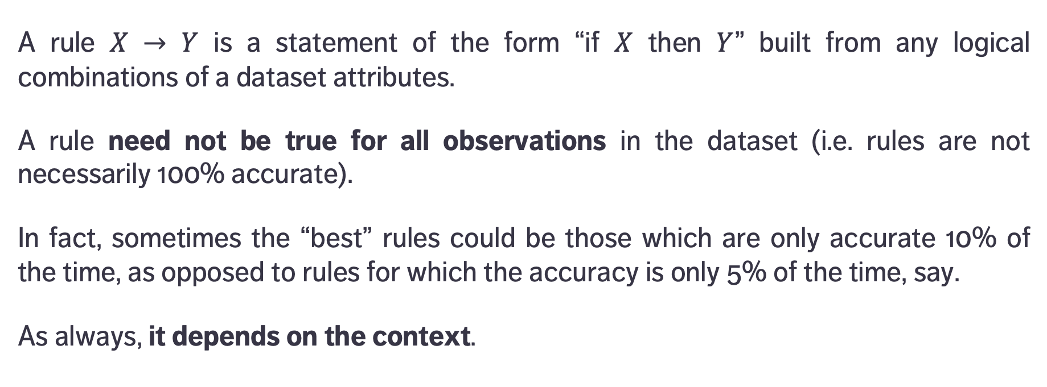
Definitions
premise
conclusion
A rule $X → Y$ is a statement of the form “if $X$ then $Y$” built from any logical combinations of a dataset attributes.
A rule need not be true for all observations in the dataset (i.e. rules are not necessarily 100% accurate).
In fact, sometimes the “best” rules could be those which are only accurate 10% of the time, as opposed to rules for which the accuracy is only 5% of the time, say.
As always, it depends on the context.

Slide 16
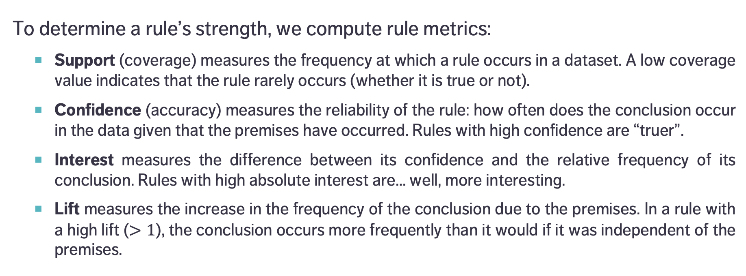
Definitions
To determine a rule’s strength, we compute rule metrics:
Support (coverage) measures the frequency at which a rule occurs in a dataset. A low coverage value indicates that the rule rarely occurs (whether it is true or not).
Confidence (accuracy) measures the reliability of the rule: how often does the conclusion occur in the data given that the premises have occurred. Rules with high confidence are “truer”.
Interest measures the difference between its confidence and the relative frequency of its conclusion. Rules with high absolute interest are… well, more interesting.
Lift measures the increase in the frequency of the conclusion due to the premises. In a rule with a high lift ($>1$), the conclusion occurs more frequently than it would if it was independent of the premises.

Slide 17
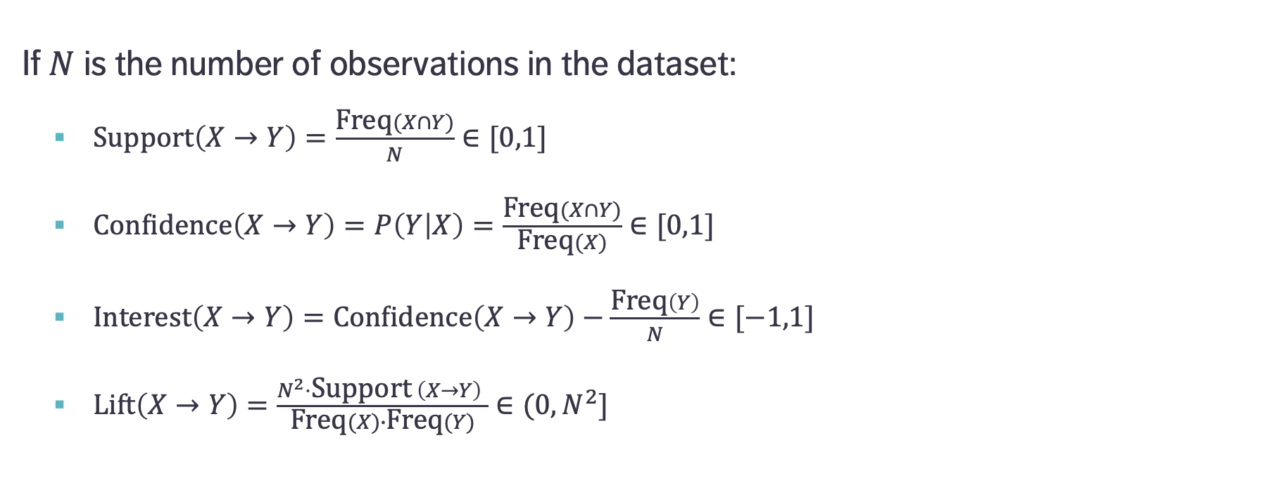
Formulas
If $N$ is the number of observations in the dataset:
$\text{Support}\left(X→Y\right)=\frac{\text{Freq}(X∩Y)}{N}∈[0,1]$
$\text{Confidence}\left(X→Y\right)=P\left(Y | X\right)=\frac{\text{Freq}(X∩Y)}{\text{Freq}(X)}∈[0,1]$
$\text{Interest}\left(X→Y\right)=\text{Confidence}\left(X→Y\right)−\frac{\text{Freq}\left(Y\right)}{N}∈[−1,1]$
$\text{Lift}\left(X→Y\right)=\frac{N^{2}⋅\text{Support} \left(X→Y\right) }{\text{Freq}(X)∙\text{Freq}(Y)}∈(0,N^{2}]$
Proportion of instances where the premise and the conclusion occur together
Proportion of instances where the conclusion occurs when the premise occurs
… ?!?

Slide 18
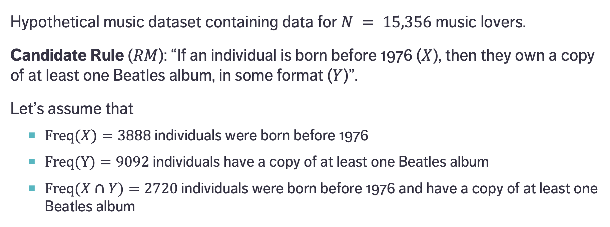
A Simple Example
Hypothetical music dataset containing data for $N = 15,356$ music lovers.
Candidate Rule ($RM$): “If an individual is born before 1976 ($X$), then they own a copy of at least one Beatles album, in some format ($Y$)”.
Let’s assume that
$\text{Freq}(X)=3888$individuals were born before 1976
$\text{Freq}(Y)=9092$ individuals have a copy of at least one Beatles album
$\text{Freq}(X∩Y)=2720$ individuals were born before 1976 and have a copy of at least one Beatles album
Notes:
Lift: 70% of those who were born before 1976 own a copy, whereas 56% of those who were born after 1976 own a copy – there is a difference, but it is not large).

Slide 19
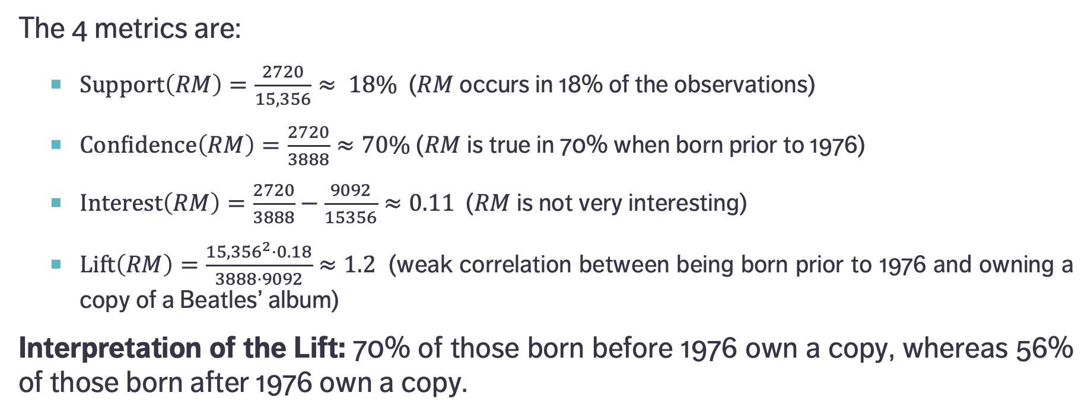
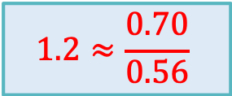
A Simple Example
$$1.2≈\frac{0.70}{0.56}$$
The 4 metrics are:
$\text{Support}\left(RM\right)=\frac{2720}{15,356}≈ 18\%$ ($RM$ occurs in 18% of the observations)
$\text{Confidence}\left(RM\right)=\frac{2720}{3888}≈70\%$ ($RM$ is true in 70% when born prior to 1976)
$\text{Interest}\left(RM\right)=\frac{2720}{3888}−\frac{9092}{15356}≈0.11$ ($RM$ is not very interesting)
$\text{Lift}\left(RM\right)=\frac{{15,356}^{2}⋅0.18}{3888⋅9092}≈1.2$ (weak correlation between being born prior to 1976 and owning a copy of a Beatles’ album)
Interpretation of the Lift: 70% of those born before 1976 own a copy, whereas 56% of those born after 1976 own a copy.

Slide 20
Brute Force Algorithm
Generate item sets (of size 1, 2, 3, 4, etc.)
e.g. {purchasing = Typical, membership = False, coupon = Yes}
Create rules from each item set
e.g. IF (purchasing = Typical AND membership = False) THEN coupon = Yes
Calculate the support, confidence, interest, lift for each rule
Retain only the rules with “high enough” coverage, accuracy, interest, and/or lift (or other metrics)
These rules are considered to be true for the dataset – they are new knowledge derived from the data

Slide 21
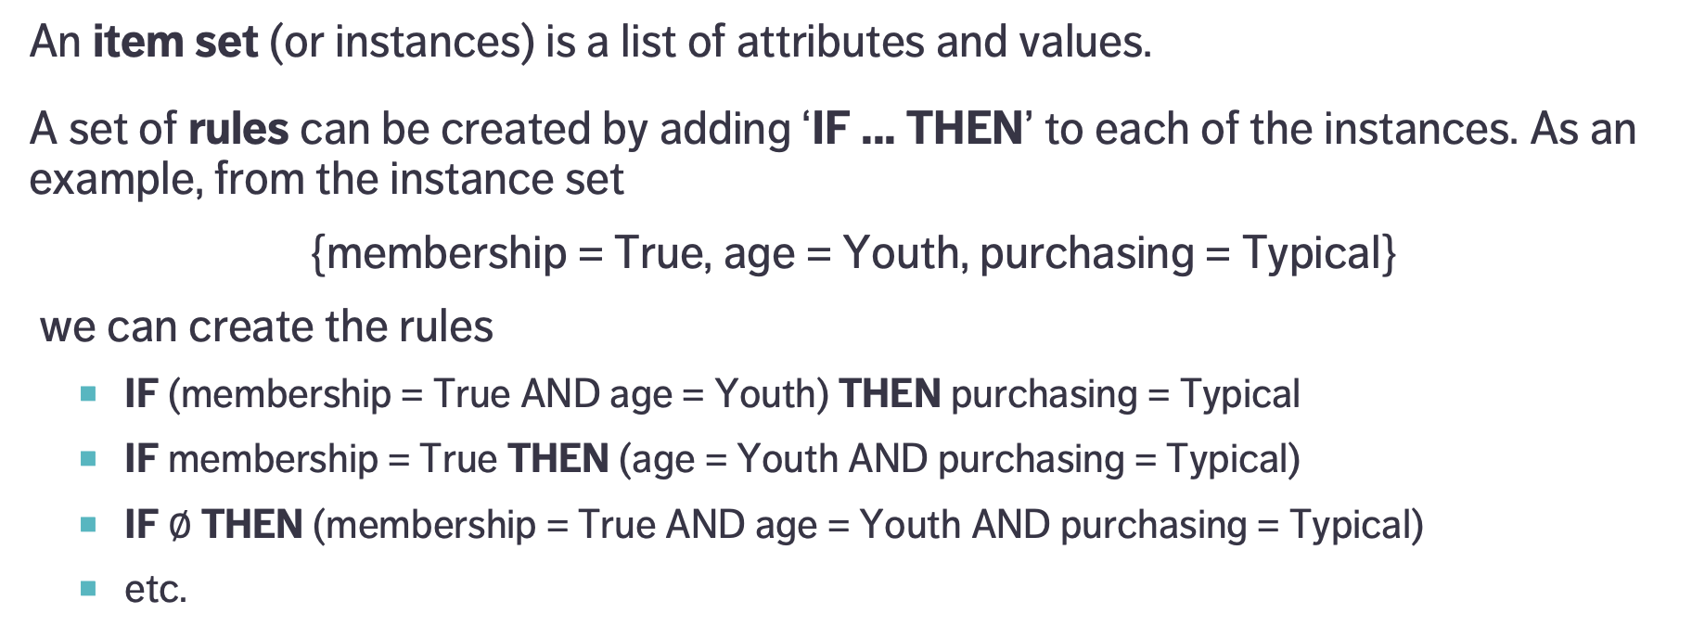
Generating Rules
An item set (or instances) is a list of attributes and values.
A set of rules can be created by adding ‘IF ... THEN’ to each of the instances. As an example, from the instance set
{membership = True, age = Youth, purchasing = Typical}
we can create the rules
IF (membership = True AND age = Youth) THEN purchasing = Typical
IF membership = True THEN (age = Youth AND purchasing = Typical)
IF $∅$ THEN (membership = True AND age = Youth AND purchasing = Typical)
etc.
Parentheses are usually dropped

Slide 22
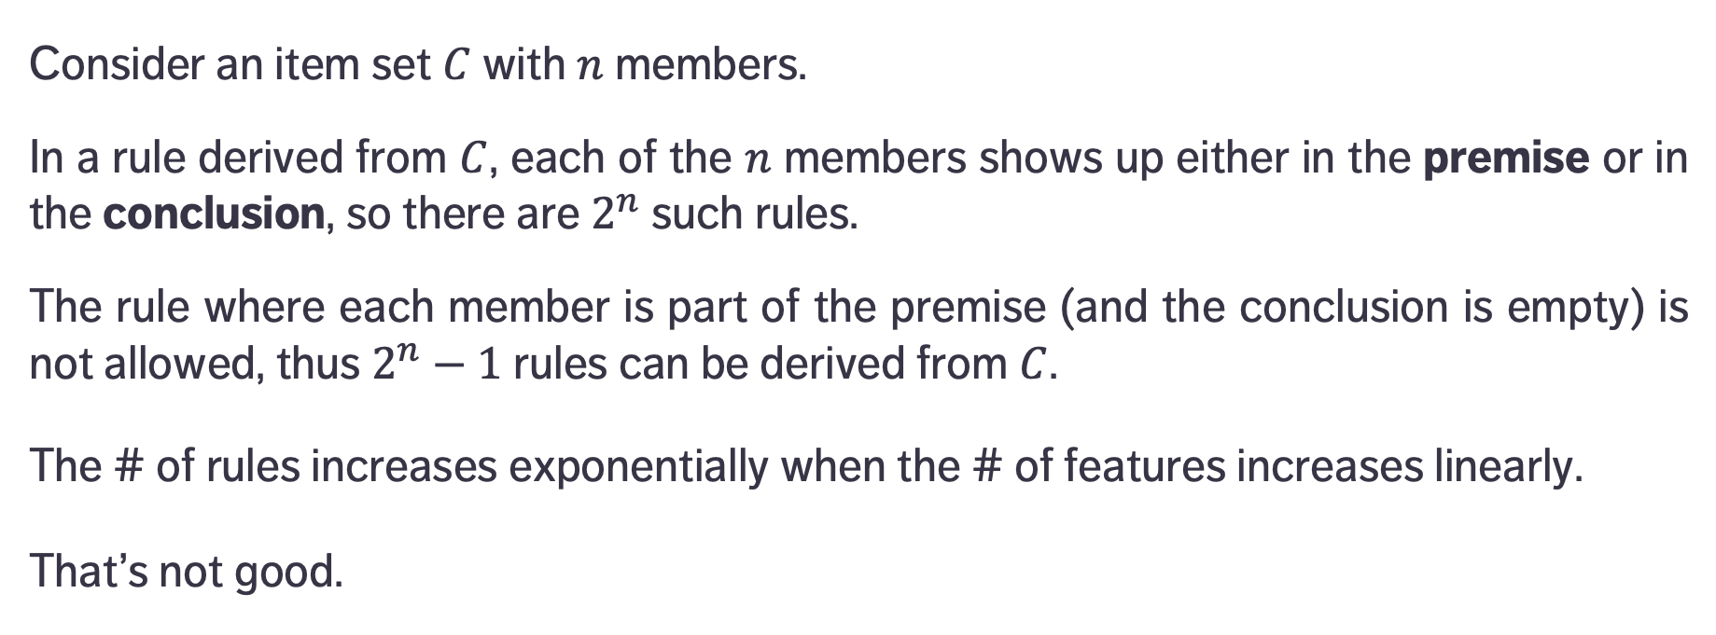
Number of Rules
Consider an item set $C$ with $n$ members.
In a rule derived from $C$, each of the $n$ members shows up either in the premise or in the conclusion, so there are $2^{n}$ such rules.
The rule where each member is part of the premise (and the conclusion is empty) is not allowed, thus $2^{n}−1$ rules can be derived from $C$.
The # of rules increases exponentially when the # of features increases linearly.
That’s not good.

Slide 23
Validation
The brute force algorithm works relatively well for small datasets (small number of features).
For Big(ger) Data, it can be costly to generate rules in that fashion (especially when the number of attributes increases). How do we generate promising candidate rules, in general?
How reliable are association rules? What is the likelihood that they occur by chance? How relevant are they? Can they be generalized outside the dataset, or to new data?

Slide 24
Notes
Since frequent rules correspond to instances that occur repeatedly in the dataset, algorithms that generate item sets often try to maximize coverage.
When rare events are more meaningful (such as detection of a rare disease), we need algorithms that can generate rare item sets. This is not a trivial problem.
A reminder, in spite of Tufte’s rejoinder: correlation is not causation.

Slide 25
Other Algorithms
Continuous vs. Categorical: continuous data has to be binned into categorical data in order for association rules to be meaningful. There’s more than one way to do that.
Item sets are sometimes called market baskets.
Other algorithms:
AIS, SETM, Apriori, AprioriTid, AprioriHybrid, Eclat, PCY, Multistage, Multihash, etc.

Slide 26
Apriori Algoritm
Developed initially for transaction data
every reasonable dataset can be transformed into a transaction dataset using dummy variables
Finds frequent item sets from which to build candidate rules
instead of building rules from all possible item sets
Starts by identifying frequent individual items in the database and extends them to larger and larger item sets, assuming these are still found frequently enough in the dataset
bottom-up approach, uses the downward closure property of support
Notes:
Developed initially for transaction data (but every data set can be transformed into a transaction dataset using dummy variables).

Slide 27
Apriori Algoritm
Prunes candidates which have infrequent sub-patterns
requires a support threshold
that threshold has to be set sufficiently high to minimize the number of frequent item sets
If a 1-item set is not frequent, any 2-item set containing it is also infrequent, for instance.
The algorithm terminates when no further successful extensions are found.
Notes:
Developed initially for transaction data (but every data set can be transformed into a transaction dataset using dummy variables).

Slide 28
Strengths and Limitations
Easy to implement, easily parallelized.
Apriori is slow and it requires frequent data set scans.
possible solutions: sampling and partitioning
Not ideal at finding rules for infrequent or rare item sets.
Other algorithms have since displaced it (historical value):
Max-Miner tries to identify frequent item sets without enumerating them; performs jumps in space instead of using bottom-up approach
Eclat is faster and uses depth-first search, but requires extensive memory storage

